Slide 1
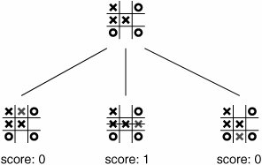
Tic Tac Toe with OpenCV and Dobot Magician
Cody Martin, Zac Clifton - Computer Science
Faculty Advisor: Suranga Hettiarachchi
Abstract
We develop a system, using Dobot Magician-robot arm, Pixie2-camera, and a Python- program to play Tic-Tac-Toe with a human player. In our program, if no motion is detected by the camera, we record current game state. Then the program differentiates between the former and current game state, and chooses an action to be carried out by the robot arm. The game completes when there are no more actions or one of the players reaches a win.
Discussion
Conclusion
Research Results
Introduction with research motivation
References
Methodology
Diagram
Dobot was 81% accurate in all trails

